Slide 1
Galaxy Zoo Morphology Classifications by CNN
Colin Leach

Slide 2
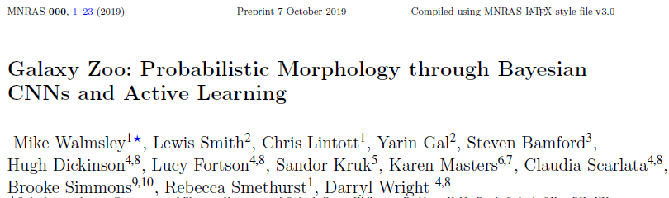
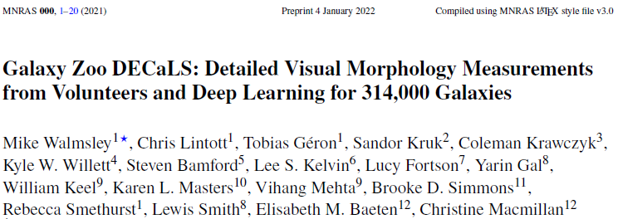
Papers
MNRAS 491, 1554 (2020)
(W+20)
MNRAS 509, 3966 (2021)
(W+21)
Better methods, better code, much better documentation

Slide 3
Links
Papers
https://ui.adsabs.harvard.edu/abs/2020MNRAS.491.1554W/abstract (W+20)
https://ui.adsabs.harvard.edu/abs/2022MNRAS.509.3966W/abstract (W+21)
Mike Walmsley repos
For W+20: https://github.com/mwalmsley/galaxy-zoo-bayesian-cnn
For W+21: https://github.com/mwalmsley/zoobot
My repo
https://github.com/colinleach/proj502

Slide 4
Objectives (original)
Get the published code running on my local machine, using whatever cut-down training set proves viable.
Deploy the code on either AWS or Google.
Extend the model to other data such as Hubble, CANDELS, DECaLS, for which there is already some GZ classification.
Think about newer CNN algorithms (W+20 used VGG16)
Rewrite using other frameworks, for my education:
PyTorch
Julia with Flux
(F# with ML.NET, but don't hold your breath waiting for that!)

Slide 5
Objectives (modified)
Get the published code running on my local machine, using whatever cut-down training set proves viable.
Deploy the code on either AWS or Google.
Use GZ2 and DECaLS data initially, perhaps others later
Think about newer CNN algorithms Stick with EfficientNet B0
Repeat with PyTorch (code from branch of mwalmsley/zoobot)
Later, rewrite using other frameworks, for my education:
Julia with Flux
(F# with ML.NET, but don't hold your breath waiting for that!)

Slide 6
Galaxy Morphology Classification

